Slide 1
Introduction to Decentralized Finance
The market for foreign currencies

Slide 2
Foreign exchange market
Exchange rate is:
Price of one nation’s money in terms of another nation’s money.

Slide 3
How does the foreign exchange market work?
As any other market, it is characterized by the interaction of demand and supply.
The price for the currency or foreign exchange rate is determined to equalize demand and supply.

Slide 4
Demand of Pounds
The demand comes from anyone who wants to buy Pounds.
US importers
US investors
Others such as tourists traveling to the UK

Slide 5
Demand for Pounds (£) in exchange of Dollars ($)
$ per £
Billions of £

Slide 6
Supply of Pounds
The supply comes from anyone who wants to sell Pounds.
UK importers
UK investors
Others such as British tourists traveling to the United States

Slide 7
Supply of Pounds (£) in exchange of Dollars ($)
$ per £
Billions of £

Slide 8
Demand and supply together
$ per £
S£
1.6
D£
300
Billions of £

Slide 9
Increase in the demand of Pounds
$ per £
S£
1.8
1.6
D£
300
320
Billions of £

Slide 10
Increase in the supply of Pounds
$ per £
S£
1.6
1.4
D£
300
320
Billions of £

Slide 11
The currency base
The exchange rate is the price of the currency we use as base.
Pound is the currency base:
The exchange rate is expressed as Dollars to buy 1 Pound.
We will talk about demand and supply of Pounds.
Dollar is the currency base:
The exchange rate is expressed as Pounds to buy 1 Dollar.
We will talk about demand and supply of Dollars.

Slide 12



Changing the currency base
I pay 1.6 Dollars
I receive 1 Pound
I pay 1/1.6 Pounds
I receive 1 Dollar

Slide 13

Changing the currency base
The Pound is the currency base
The Dollar is the
currency base
$ per £
£ per $
S£
S$
Supply of £
becomes demand of $
1.80
$$=\frac{1}{1.60}$$
1.60
0.625
Demand of £
becomes supply of $
0.555
D£
D$
300
320
Billions of £
480
576
Billions of $

Slide 14
Arbitrage
A currency is traded in many locations.
Arbitrage guarantees that the price is the same in different trading locations.

Slide 15




Trading Pounds in London and New York
London
New York
I pay 1.5 Dollars
I pay 1.7 Dollars
I receive 1 Pound
I receive 1 Pound

Slide 16
Arbitrage
London
New York
I pay 1.5 Dollars
I pay 1.7 Dollars
I receive 1 Pound
I receive 1 Pound
Buy 1 Pound in London paying 1.5 Dollars
Resell 1 Pound in New York for 1.7 Dollars

Slide 17
Price equalization
London
New York
I pay 1.6 Dollars
I pay 1.6 Dollars
I receive 1 Pound
I receive 1 Pound

Slide 18
Determinants of the Exchange Rate

Slide 19
Determinants of the exchange rate
Short-run
The exchange rate is mostly determined by portfolio repositioning of assets denominated in foreign currencies and business cycle.
Long-run
The exchange rate is determined by the Purchasing Power Parity (PPP).

Slide 20

Exchange rate in the long-run
Real Exchange Rate (RER):
The price of domestic produced goods relatively to the price of foreign produced goods, expressed in the same currency:
$$RER=\frac{Price of domestic goods}{Price of foreign goods}$$

Slide 21

Formula for the RER (Ratio between domestic and foreign prices when prices are expressed in the same currency)
$$RER=\frac{e_{nom}∙P}{P_{For}}$$
e_{nom} = Nominal exchange rate (foreign currency to buy one unit of domestic currency)
P = Domestic price in domestic currency
P_{For} = Foreign price in foreign currency

Slide 22





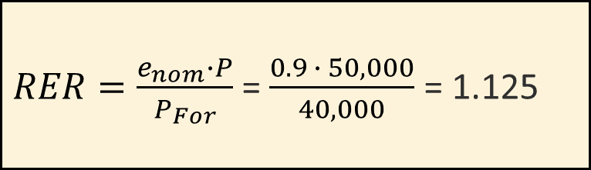
Example: Computing the RER
Consider a European car: AUDI A4
Price in Europe: €40,000
Price in the United States: $50,000
Nominal exchange rate: 0.9 € / $
I pay 0.9 Euro
I receive 1 Dollar
$RER=\frac{e_{nom}∙P}{P_{For}}$ = $\frac{0.9 ∙ 50,000}{40,000}$ = 1.125

Slide 23
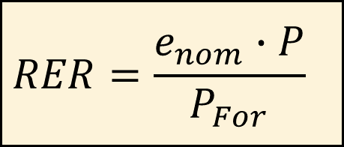
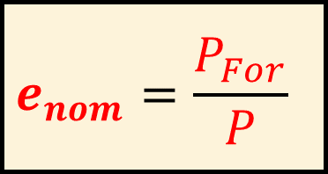
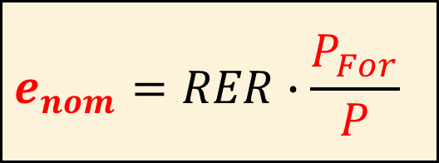
Purchasing Power Parity (PPP)
Purchasing Power Parity Theory:
The real exchange rate is always equal to 1. Thus, the nominal exchange rate is only determined by the relative nominal prices (law of one price).
$$RER=\frac{e_{nom}∙P}{P_{For}}$$
Inverting
$$e_{nom}=RER∙\frac{P_{For}}{P}$$
$$e_{nom}=\frac{P_{For}}{P}$$
RER=1

Slide 24
Undervalued and overvalued currencies
A currency is undervalued if:
Domestic goods are cheaper than foreign goods,
that is, RER<1.
A currency is overvalued if:
Domestic goods are more expensive than foreign goods, that is, RER>1.

Slide 25


What happens if RER differs from 1?
If a currency is undervalued (RER<1), PPP theory predicts that the nominal value of the currency should appreciate:
If a currency is overvalued (RER>1), PPP theory predicts that the nominal value of the currency should depreciate.
$$RER=\frac{e_{nom}∙P}{P_{For}}$$
$$RER=\frac{e_{nom}∙P}{P_{For}}$$

Slide 26
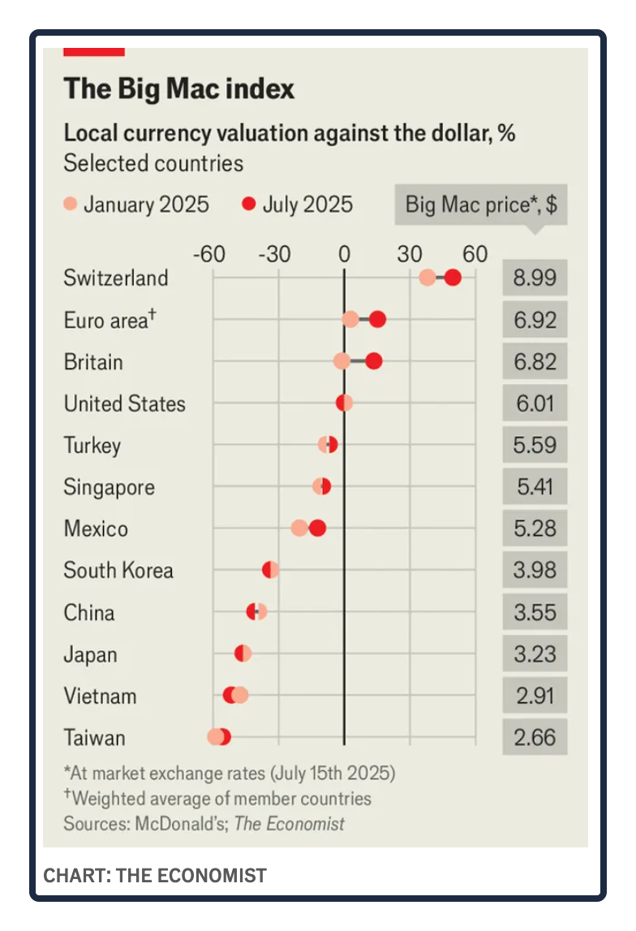


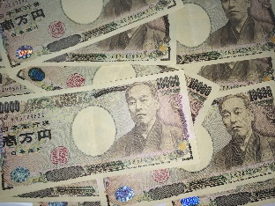
Swiss Franc is “over-valued”
compared to the US Dollar
PPP
Franc should depreciate
Japanese Yen is “under-valued”
compared to the US Dollar
PPP
Yen should appreciate

Slide 27
Conditions required for PPP (law of one price) hold
Goods are tradable.
Transportation costs are low.
There are no artificial barriers to trade.

Slide 28

Implications of PPP?
$$e_{nom}=\frac{P_{For}}{P}$$
% change e_{nom} = % change P_{For} - % change P
Appreciation rate of domestic currency =
Foreign inflation - Domestic inflation

Slide 29
Exercise
During the last 50 years,
the average inflation rate in Columbia has been 20 percent per year;
the average inflation rate in Chile has been 50 percent per year.
Questions:
1. Given the inflation rates in Columbia and in Chile, should the Columbian Peso have appreciated or depreciated in norminal terms with respect to the Chilean Peso during the last 50 years?
2. By how much?
3. If the nominal value of the Columbian Peso has appreciated 10 percent annually relatively to the Chilean Peso, has the Columbian Peso appreciated or depreciated in Real terms relatively to the Chilean Peso?

Slide 30
Is the Purchasing Power Parity theory supported by the data?

Slide 31
Annual inflation rate

Slide 32
Annual inflation rate
Annual depreciation rate

Slide 33
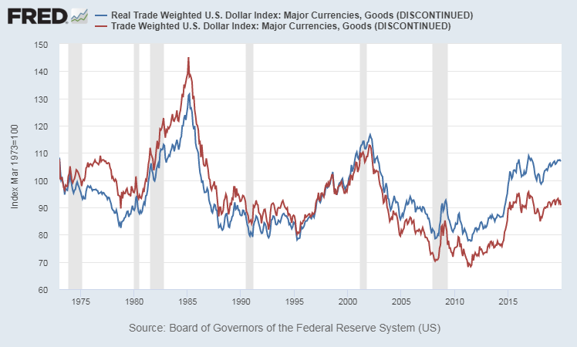
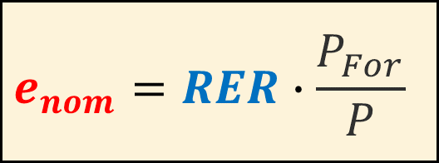
Nominal and real exchange rate of US dollar
(Index normalized to 100 on March 1973)
Nominal exchange
rate index
Real exchange
rate index
$$e_{nom}=RER∙\frac{P_{For}}{P}$$

Slide 34
Real exchange rate and net exports
The real exchange rate impacts the quantities of goods and services that are exported and imported.
A weaker domestic currency
facilitates the country’s exports of goods and services;
discourages the country’s imports of goods and services.
Changes in net exports affect the overall economic activity.
Countries may then have an incentive to affect the Real Exchange Rate by implementing policies that impact on the Nominal Exchange Rate (“currency manipulation”).

Slide 35
Is China a currency manipulator?

Slide 36
Has the “Real” value of the Chinese Yuan depreciated? (See spreadsheet posted inGitHub)

